Slide 1
AIRFRAME PROGRESS REPORT WK.7
MARK ODHIAMBO AND VIVIAN MWANGI.

Slide 2
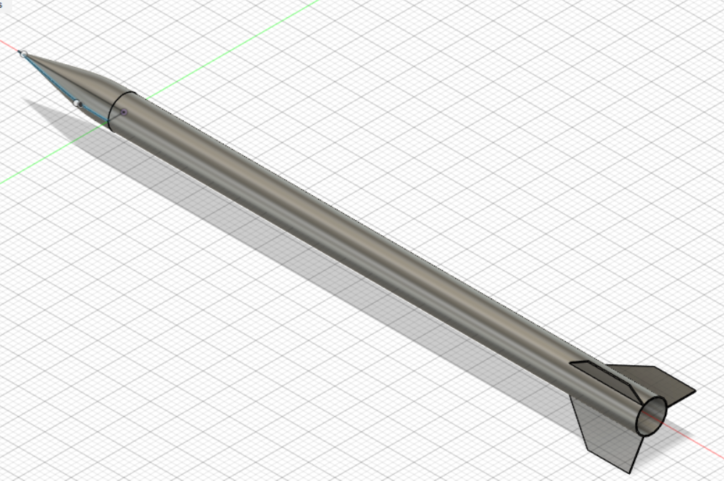
GITHUB #114[UPDATED THE CAD DESIGN.]

Slide 3
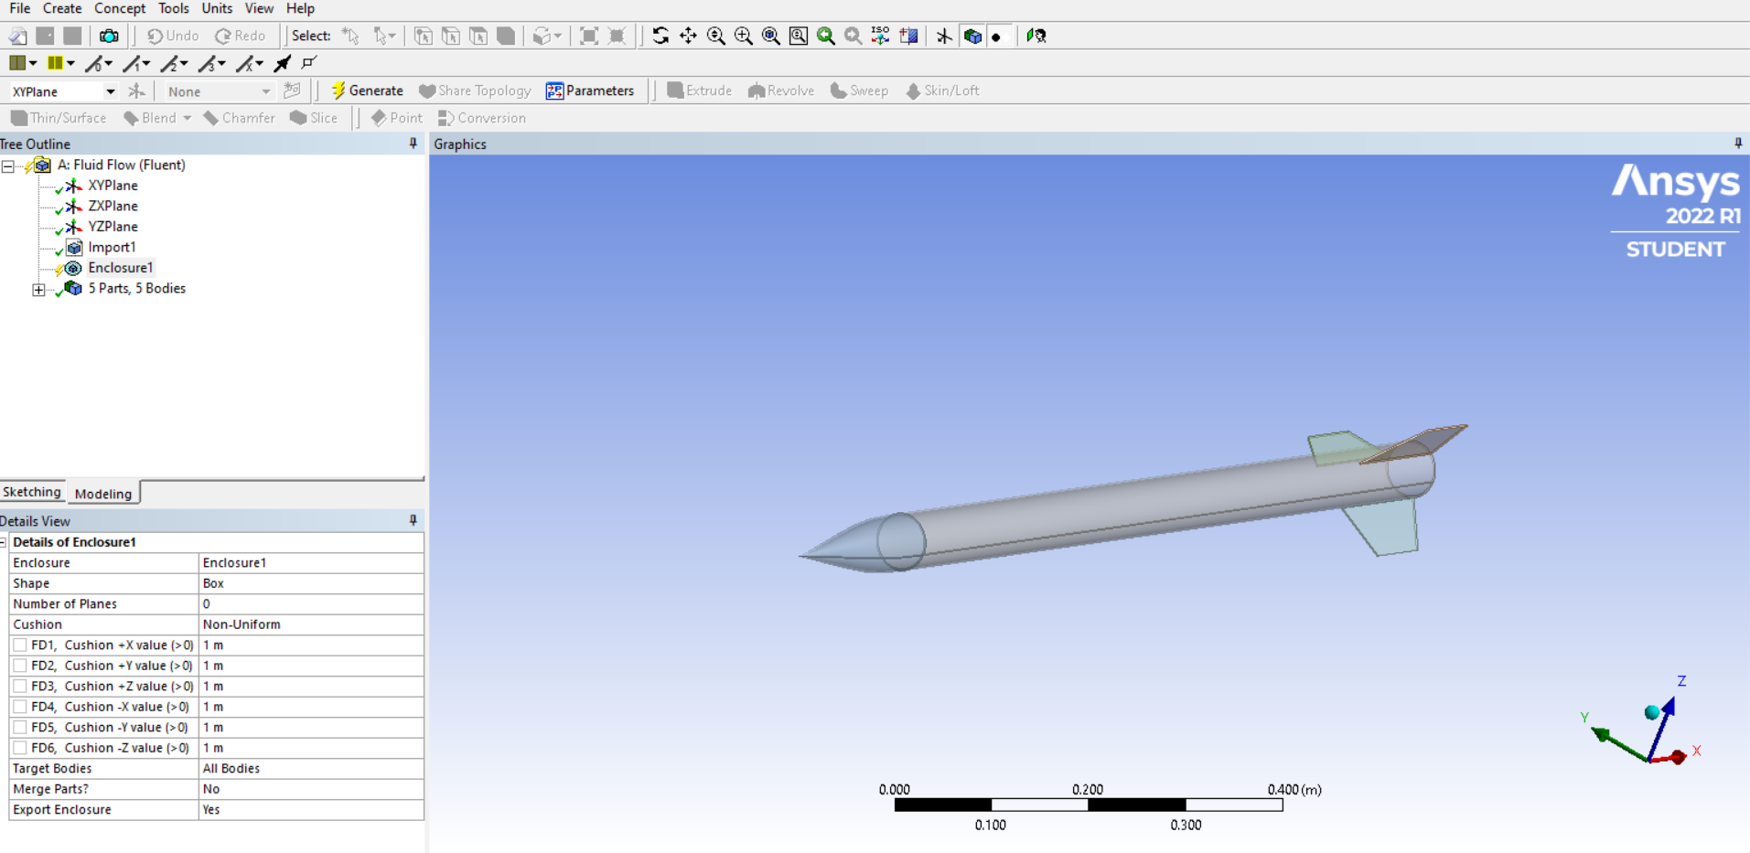
GITHUB #93[CFD SIMULATION]

Slide 4
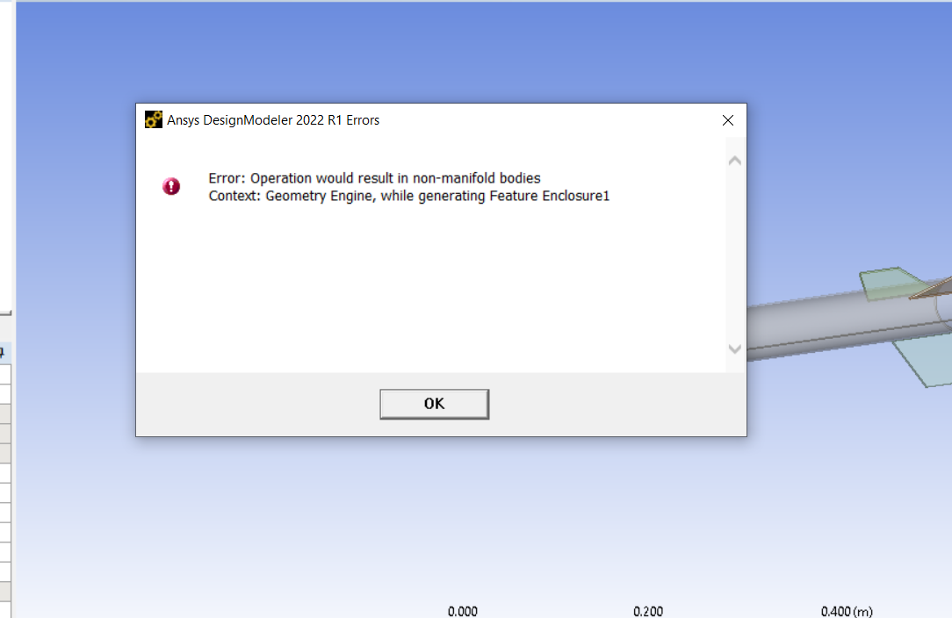
Error in the cfd simulation.

Slide 5
GITHUB #106[THIRD FABRICATION]
The results of the third fabrication were better than that of the 2nd one the body tube had less air bubbles.
The tube should be turned to reduce thickness.

Slide 6
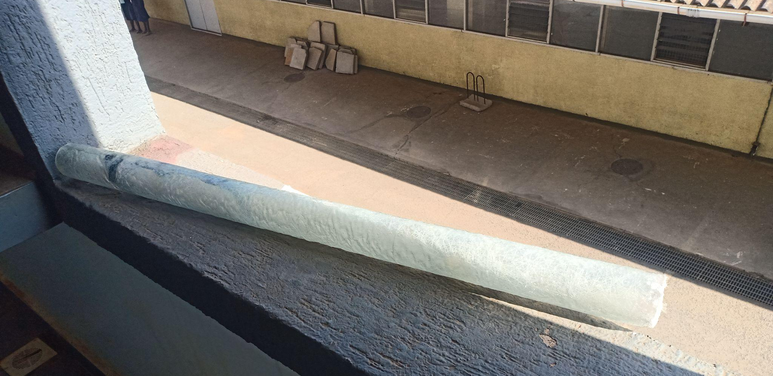

Slide 7
TASKS TO BE DONE.
GITHUB #115 [3D PRINT NOSE CONE]
GITHUB #116 [MATERIAL ACQUISITION(RESIN)]
GITHUB #117 [POST FABRICATION OF BODY TUBE]

